Slide 1

Emotion Analysis using Opinion Mining
NAME | ROLL NUMBER
Prakhar Dogra | 2K12/CO/086
Shubham Varshney | 2K12/CO/126
Vikas | 2K12/CO/139
Vikrant Dabas | 2K12/CO/140

Slide 2
Our Goal
The goal of our project is to do emotion analysis on tweets using opinion mining. The main idea of the project is to create a model that is able to predict the type of emotion of a tweet using web mining to initially extract tweets using the Twitter API and then further using sentiment analysis to analyse the emotions. The model is made using two modules that are named as follows:
1. Data cleaning module
2. Scoring (emotion value) module
This model is followed by another module that is used for creation and further expansion of an independent dictionary that stores the emotion values of adjectives, adverbs and verbs that are not identified by the original dictionary.

Slide 3
System Architecture
We now present the architecture of the system proposed for our emotion analysis.It mainly involves:
Tweet retrieval Module
Preprocessing (cleaning) Module
POS Tagging
Emotion Scoring Module
Dictionary Expansion Module

Slide 4
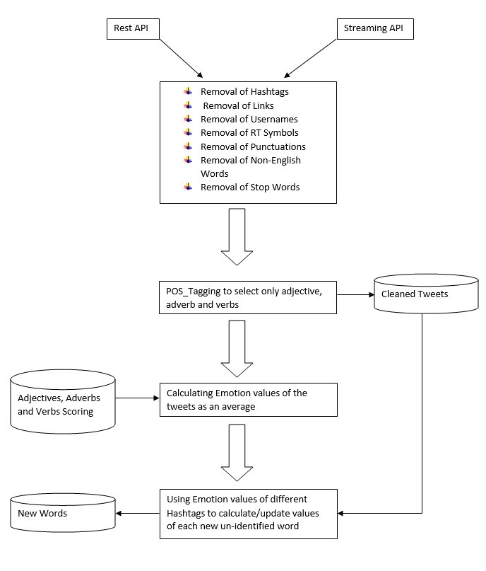

Slide 5
Downloading of Data
If we want to get large publically available Twitter datasets is through their API.
We access the API through the tweepy python package
The Twitter API has two different flavors: RESTful and Streaming.
The RESTful API is useful for getting things like lists of followers and those who follow a particular user, and is what most Twitter clients are built off of.
The Streaming API works by making a request for a specific type of data — filtered by keyword, user, geographic area, or a random sample — and then keeping the connection open as long as there are no errors in the connection.

Slide 6
Why select a microblogging website like Twitter?
It is used by people of different domains to express their emotions, views and opinions.
It contains sheer amount of text posts that grows at large rate everyday.
It is used by people from many countries.
It involves variety of people from ordinary users to celebrities of various fields like entertainment, sports, politics, education, etc.

Slide 7
Raw v/s Cleaned Data
Raw data is the original data and is often hard to use for analysis directly.
Raw data may only be need to process only once (during cleaning).
Processed Data is ready for analysis.
Processing of raw data includes removal of hashtags, links, usernames, punctuations, non-english words and symbols like RT.

Slide 8
Data Cleaning Process
The following strategy has been followed to make the downloaded twitter data tidy
For Removal of #tags, a substring removal python function is used.
Similar to the removal of hashtags, substring removal function is used to remove the links in the tweets.
Each punctuation is replaced by an empty substring
Removal of strings generally present in tweets such as RT, @someUser etc. through the substring removal function.
Removal of non-English tweets by encoding them into ASCII and if encoding produces any exception, then reject them , otherwise, select the tweets.
Removal of stopping words through nltk library.

Slide 9
Data Cleaning Process Implemented
The substring removal function removes the part of the string that contains a substring eg. if substring = 'http' , then http://www.google.com is removed, that means, remove until a space is found.
Substring removal function has been very useful in removing the links, as well as retweets, hashtags and some other undesired content from the tweets.

Slide 10
Data Cleaning Process Implemented
def isEnglish(s):
try:
s.encode('ascii')
except UnicodeEncodeError:
return False
else:
return True
The above function decides if a character is english or non English.We select English-Only tweets.

Slide 11
Data Cleaning Process Implemented
NLTK is a leading platform for building Python programs to work with human language data.
It provides easy-to-use suite of text processing libraries for tokenization and tagging.
NLTK has been used to remove the stopping words from all the tweets.
Words are fed to the Part of Speech tagger after Sentence Tokenizer and Word Tokenizer is applied.
Only adjectives, adverbs and verbs have been retained.All other words are discarded.

Slide 12
Proposed Scoring Modules
We have proposed several scoring methods/formulas to calculate the average emotion value of tweets of a handle(username) or hashtag:
Emotion value = sum of adjective values + sum of adverb and verb values
(no. of adjectives * 5) + no. of adverb and verb
2. Multiply the value of adverb/verb with the upcoming adjective . If two verb /adverb are next to each other, simply multiply them. And then all these products are added. Further divided by 5*number of adjectives encountered.
3. If the value of adverb/verb is less than 0 i.e, negative , then for the upcoming adjective, subtract its value from 5 instead of multiplying . And if value of verb/adverb is positive and >= 0.5 then multiply it with the upcoming adjective else multiply 0.5 with upcoming adjective. Later these products are added and the sum is divided by 5*number of adjectives encountered.
4. Since the emotions are independent of each other, we should treat them independently and use a different formula for each emotion. We have used normalising values of different emotions. These predefined values are used to normalize the emotion values. In this method an assumption is taken that if an emotion is strong it’s respective value is > 3 (out of a scale of 5).

Slide 13
Scoring Module-I
This algorithm is based on the idea that every emotion is distinct from one another and thus the formula used to calculate the required emotion value is different from one another. The general method used is:
if sum of emotion values of all adjectives/number of adjectives > 3
then emotion value = sum of adjectives/normalising factor + sum of adverb & verbs
total number of adjectives, adverbs and verbs
else
emotion value = sum of adjectives/normalising factor - sum of adverb & verbs
total number of adjectives, adverbs and verbs
The normalising factor varies for each emotion and hence gives a different formula for each emotion. This normalising factor has been calculated on a common scale of 0 to 5 using the images of brain scans of prefrontal cortex.
There is an assumption that words with emotion value(0-5) > 3 for an adjective express stronger feelings. Whereas the other express weaker feelings.

Slide 14
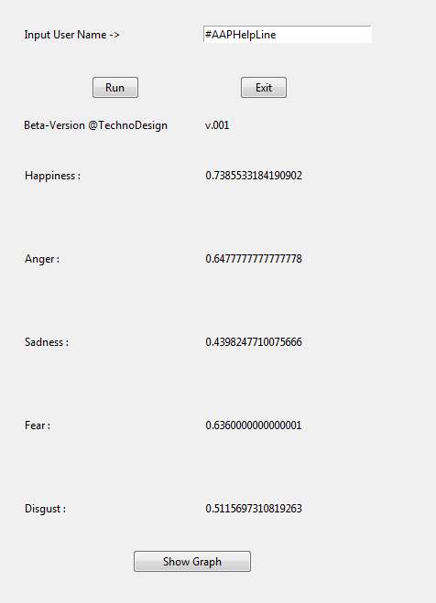
Emotion Values when 1000 tweets are downloaded from #AAPHelpLine

Slide 15
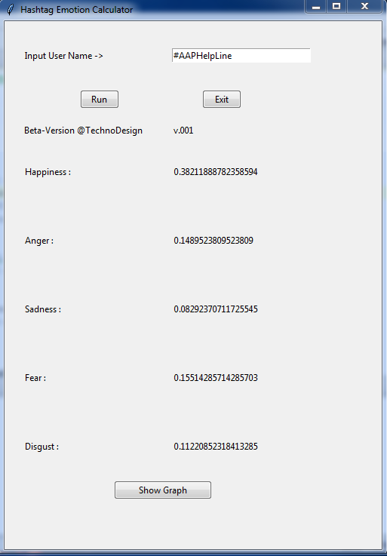
Emotion Values when 1000 tweets are downloaded from #AAPHelpLine

Slide 16
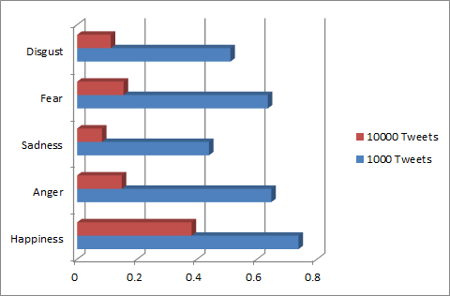
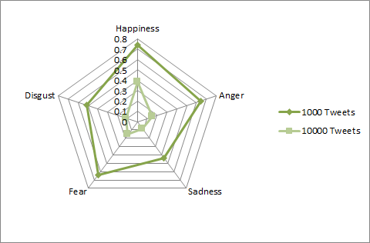
Bar Graph and spider chart of emotion values

Slide 17
Emotion values obtained after running scoring module-I
#KKRvMI
[0.7462074205394457, 0.5345660377358491, 0.36526678839521215, 0.5464150943396225, 0.42622393713051787]
#HatsOffGeneral
[0.6559385804352247, 0.5851515151515151, 0.4570381231671554, 0.6407878787878786, 0.48634089487748006]
#AAPBreakUp
[0.513160198424278, 0.658608695652174, 0.5149135109864423, 0.7370434782608694, 0.5559507300758625]
#AAPKaSting
[0.6301374240971556, 0.6177142857142858, 0.3960914831882573, 0.6784761904761903, 0.5191548289109265]
#AAPWAR
[0.9884563758389262, 0.5514666666666667, 0.4148148148148148, 0.5954666666666666, 0.459537210756723]

Slide 18
Scoring Module-II
This algorithm is based on the idea that whenever there is an adverb/verb in front of an adjective there is bound to be an effect on the emotion expressed by the same adjective. It can be either negative or negative. Keeping this in mind we have created method to calculate the emotion values.
If the value of adverb/verb is less than 0 i.e, negative , then for the upcoming adjective, subtract its value from 5 instead of multiplying . And if value of verb/adverb is positive and >= 0.5 then multiply it with the upcoming adjective else multiply 0.5 with upcoming adjective. Later these products are added and the sum is divided by 5*number of adjectives encountered.
And if there are more than 1 adverbs/verbs before an adjective then they are multiplied together.

Slide 19
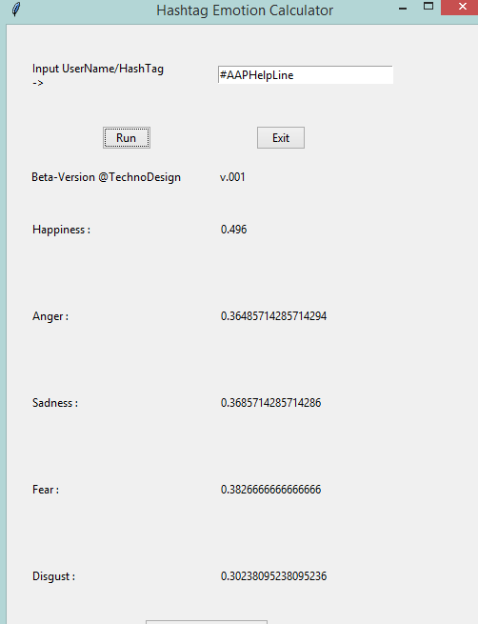
Emotion Values when 1000 tweets are downloaded from #AAPHelpLine

Slide 20
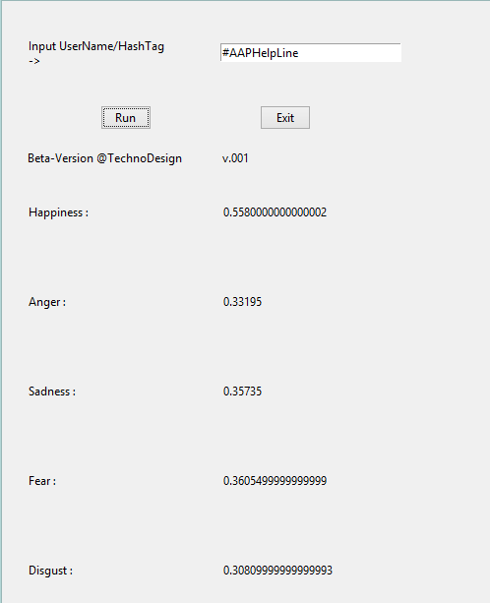
Emotion Values when 1000 tweets are downloaded from #AAPHelpLine

Slide 21
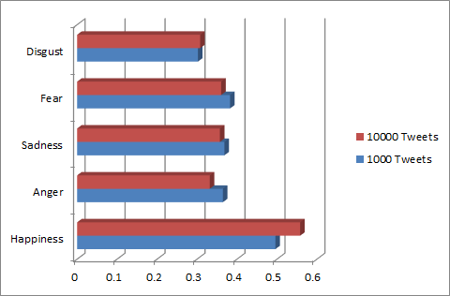
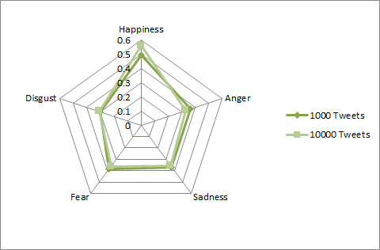
Bar Graph and spider chart of emotion values

Slide 22
Emotion values obtained after running scoring module-I
#KKRvMI
[0.556704761904762, 0.3601809523809524, 0.36324761904761915, 0.39180317460317454, 0.28949206349206347]
#HatsOffGeneral
[0.5512065573770494, 0.34857377049180316, 0.3657344262295083, 0.3835344262295082, 0.3112327868852459]
#AAPBreakUp
[0.4824, 0.4449333333333334, 0.44599999999999984, 0.49839999999999995, 0.39799999999999996]
#AAPKaSting
[0.517384, 0.420964, 0.390636, 0.4327319999999999, 0.37956399999999996]
#AAPWAR
[0.7349411764705883, 0.28094117647058825, 0.2952941176470588, 0.30388235294117644, 0.24988235294117644]

Slide 23
Dictionary Expansion Module
The main idea of this module is to create a dictionary apart from the original dictionary being used.
This module will be run after the scoring module for a hashtag or user-handle has been run.
The emotion values from the scoring modules will be fed into this module and those values will be assigned to words (adjective/verb/adverb) that haven’t been identified by the original dictionary. Now this module is separate from the model and uses emotion values of every iteration of the model to expand it’s dictionary and update already used words.
This module is designed to input emotion values of a hashtag or a user-handle. But it can be modified to process the tweets one by one.
This module has yet to be integrated into the main model

Slide 24
Work Yet to be Done
Following is the list of functionalities/modules that haven’t been added in the model:
Spell Correction module: This module is required to convert the shorthand notations that usually used in tweets into proper words so as to make them visible to POS_tag function. This module has to be implemented before the usage of POS_tagging.
Emoticon processor: Emoticons are heavily used in tweets but since they are non-english words so they are removed in the cleaning module. So they need to be identified before that.
Apriori Association: We haven’t used any association rule between adverb/verb-adjective pair (or triplet). This method will provide a method that shows how much the adverb/verb affects the following adjective.
kNN Classifier: This classifier has to be used after the scoring module. When we encounter a tweet from the same hashtag we will classify using the kNN classification method into one of the pre-defined classes.

